Slide 1
<DATA STRUCTURES AND ALGORITHM>

Slide 2
VIII. SORTING

Slide 3
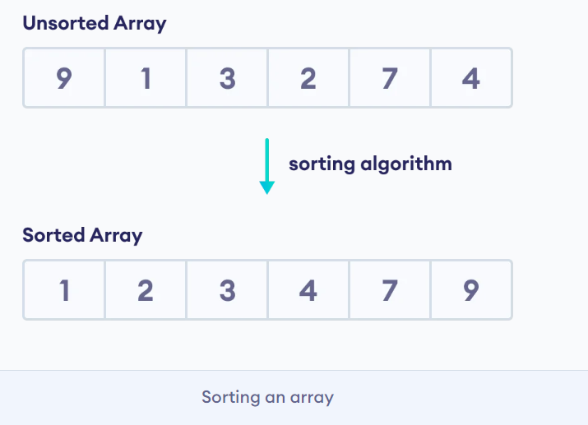
SORTING
Sorting is an algorithm that arranges the elements of a list in a certain order [either ascending or descending]. The output is a permutation or reordering of the input.
A sorting algorithm is used to arrange elements of an array/list in a specific order. For example:

Slide 4
WHY IS SORTING NECESSARY?
Sorting is one of the important categories of algorithms in computer science and a lot of research has gone into this category. Sorting can significantly reduce the complexity of a problem, and is often used for database algorithms and searches.
The importance of sorting lies in the fact that data searching can be optimized to a very high level, if data is stored in a sorted manner. Sorting is also used to represent data in more readable formats.

Slide 5
WHY IS SORTING NECESSARY?
Following are some of the examples of sorting in real-life scenarios:
Telephone Directory − The telephone directory stores the telephone numbers of people sorted by their names, so that the names can be searched easily.
Dictionary − The dictionary stores words in an alphabetical order so that searching of any word becomes easy.

Slide 6
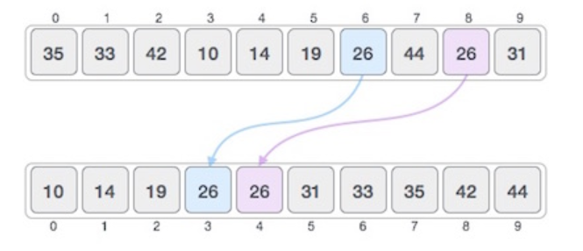
STABLE AND NOT STABLE SORTING
If a sorting algorithm, after sorting the contents, does not change the sequence of similar content in which they appear, it is called stable sorting.

Slide 7
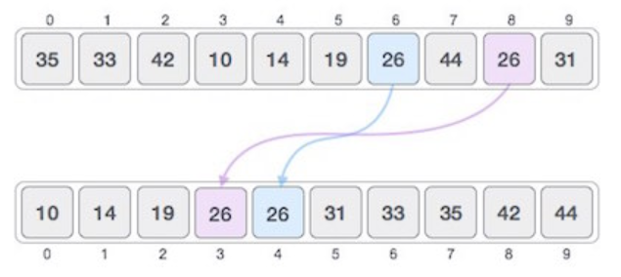
STABLE AND NOT STABLE SORTING
If a sorting algorithm, after sorting the contents, changes the sequence of similar content in which they appear, it is called unstable sorting.

Slide 8
TYPES OF SORTING
Sorting algorithms may require some extra space for comparison and temporary storage of few data elements.
Internal Sort(In-place Sorting): These algorithms do not require any extra space and sorting is said to happen in-place, or for example, within the array itself. Sort algorithms that use main memory exclusively during the sort. Eg: Bubble Sort, Selection Sort, Insertion Sort, Quick Sort.
External Sort(Not-in-place Sorting): Sorting algorithms that use external memory, such as tape or disk, during the sort come under this category. Eg: Merge Sort

Slide 9
TYPES OF SORTING
Bubble-Sort
Selection-Sort
Insertion-Sort
Merge-Sort
ETC…

Slide 10
BUBBLE SORT
Bubble sort is the simplest sorting algorithm. It works by iterating the input array from the first element to the last, comparing each pair of elements and swapping them if needed. Bubble sort continues its iterations until no more swaps are needed. This algorithm is not suitable for large data sets as its average and worst case complexity are of Ο(n²) where n is the number of items.
Ex: bubblesort.c

Slide 11
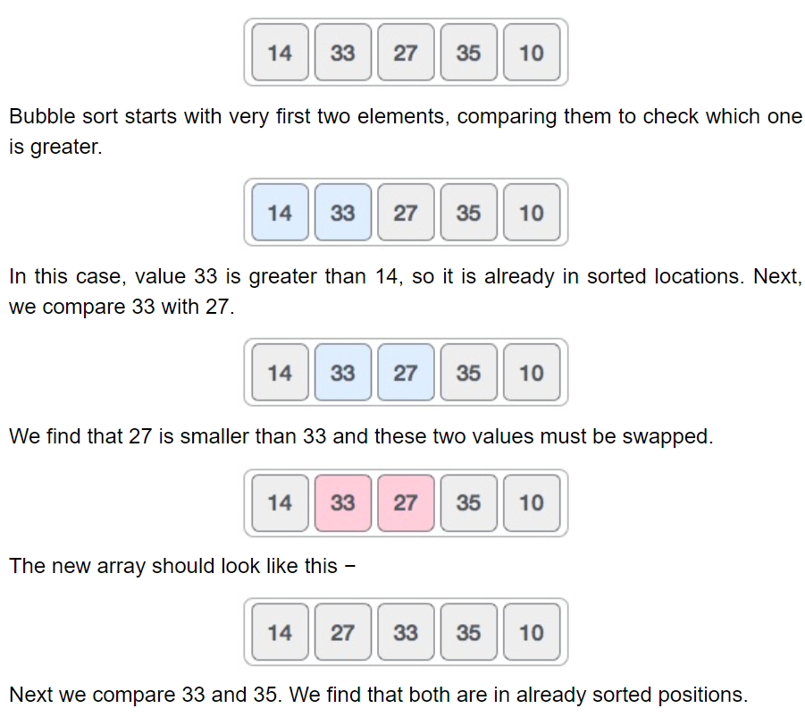
BUBBLE SORT

Slide 12
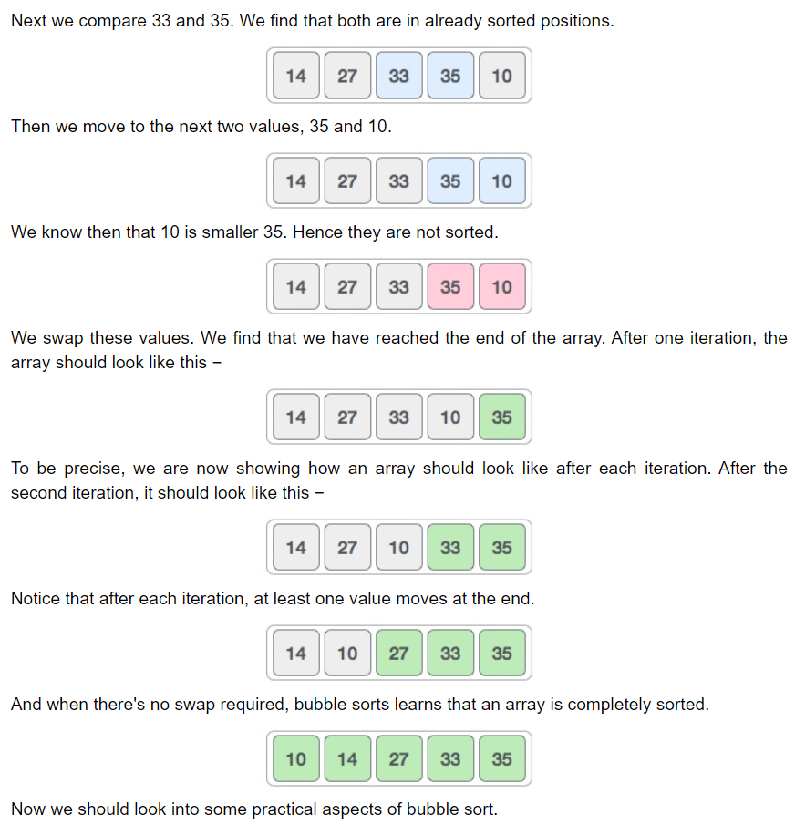
BUBBLE SORT

Slide 13
SELECTION SORT
Selection sort is a simple sorting algorithm. This sorting algorithm is an in-place comparison-based algorithm in which the list is divided into two parts, the sorted part at the left end and the unsorted part at the right end. Initially, the sorted part is empty and the unsorted part is the entire list.
The smallest element is selected from the unsorted array and swapped with the leftmost element, and that element becomes a part of the sorted array. This process continues moving unsorted array boundary by one element to the right.
This algorithm is not suitable for large data sets as its average and worst case complexities are of Ο(n²), where n is the number of items.

Slide 14
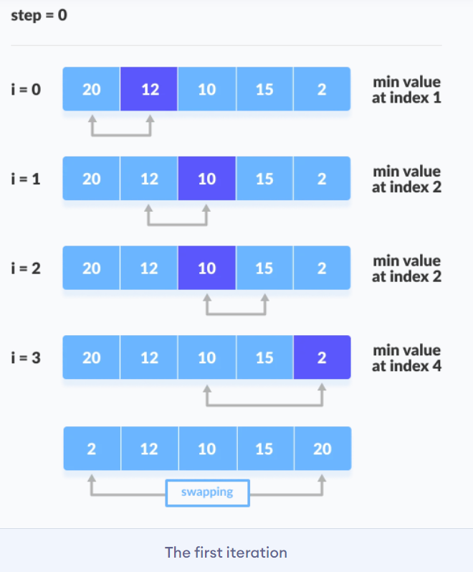
SELECTION SORT

Slide 15
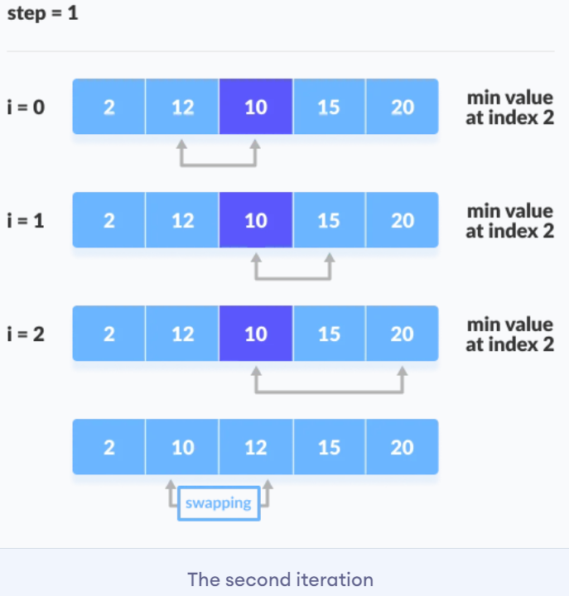
SELECTION SORT

Slide 16
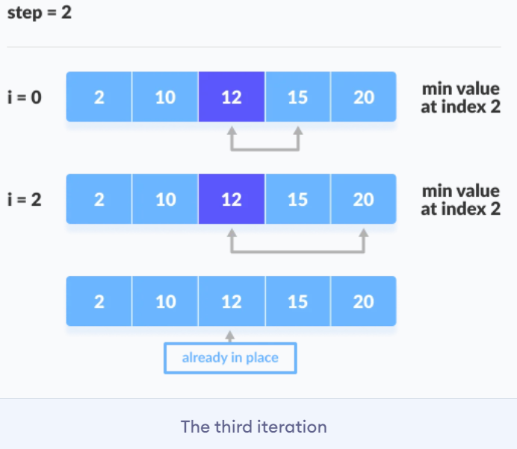
SELECTION SORT

Slide 17
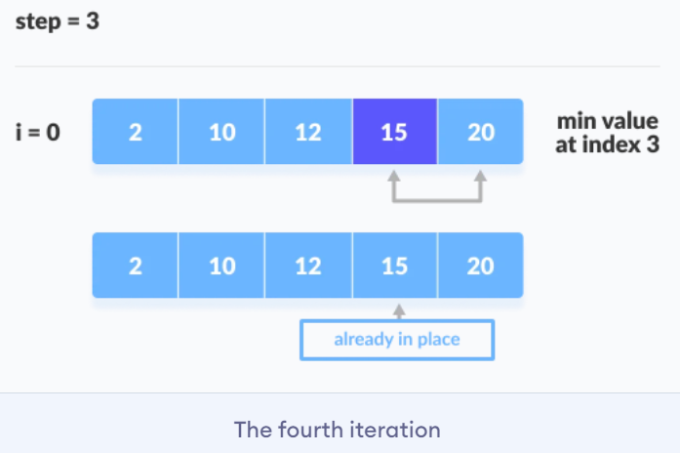
SELECTION SORT
Ex: selectionsort.c

Slide 18
INSERTION SORT
Insertion sort is a simple and efficient comparison sort. In this algorithm, each iteration removes an element from the input data and inserts it into the correct position in the list being sorted. The choice of the element being removed from the input is random and this process is repeated until all input elements have gone through.
Insertion sort works similarly as we sort cards in our hand in a card game. We assume that the first card is already sorted then, we select an unsorted card. If the unsorted card is greater than the card in hand, it is placed on the right otherwise, to the left. In the same way, other unsorted cards are taken and put in their right place.

Slide 19
INSERTION SORT
The array is searched sequentially and unsorted items are moved and inserted into the sorted sub-list (in the same array). This algorithm is not suitable for large data sets as its average and worst case complexity are of Ο(n²), where n is the number of items.
Eg: insertionsort.c

Slide 20
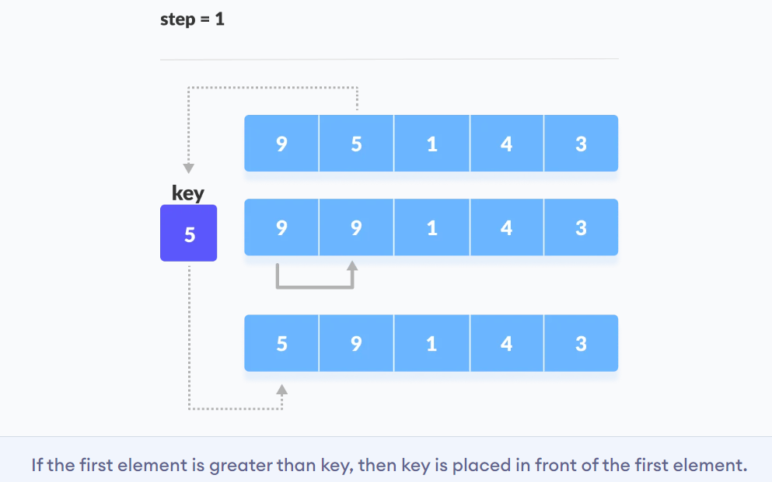
INSERTION SORT

Slide 21
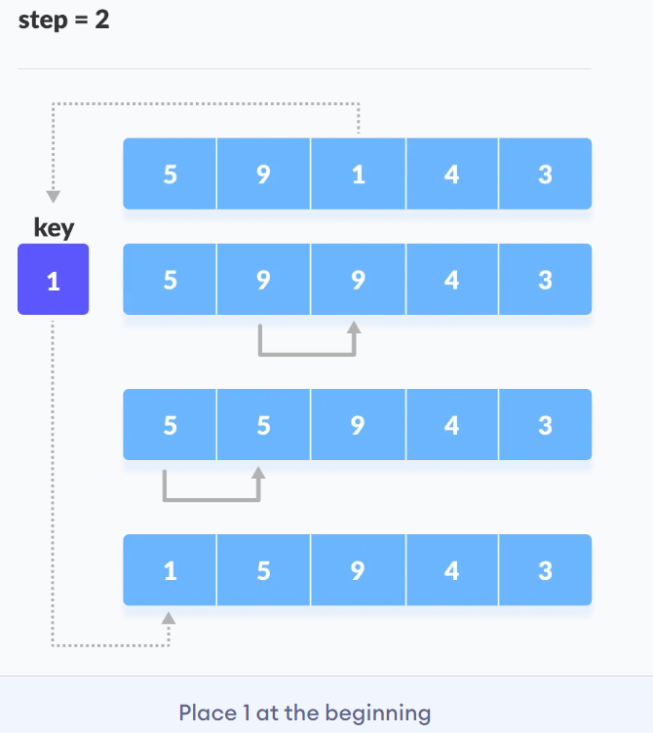
INSERTION SORT

Slide 22
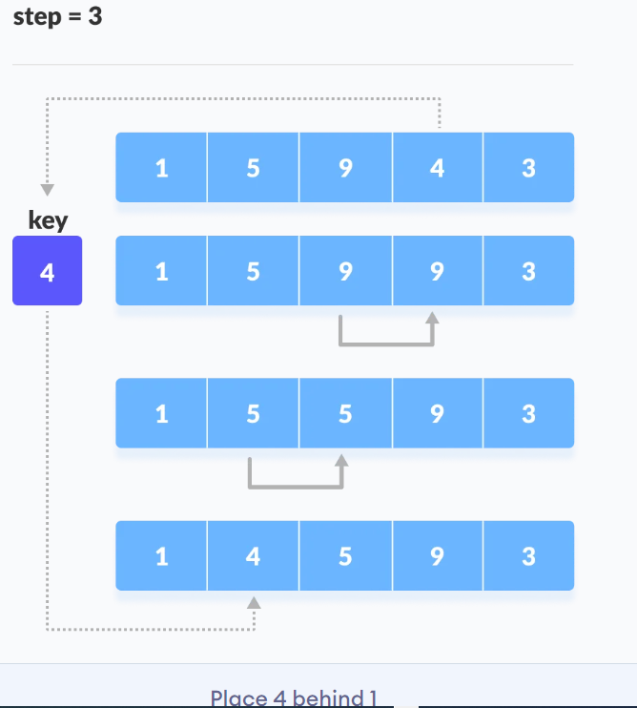
INSERTION SORT

Slide 23
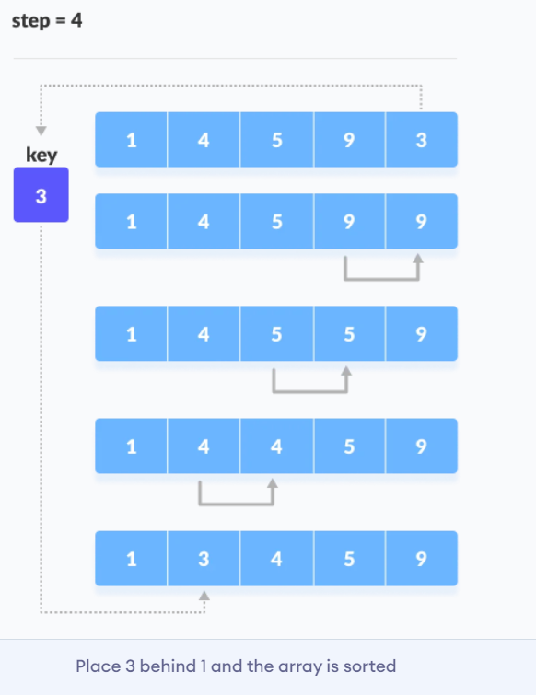
INSERTION SORT

Slide 24
MERGE SORT
Merge Sort is one of the most popular sorting algorithms that is based on the principle of Divide and Conquer Algorithm.
With worst-case time complexity being Ο(n log n), it is one of the most respected algorithms.
Merge sort first divides the array into equal halves and then combines them in a sorted manner.
Here, a problem is divided into multiple sub-problems. Each sub-problem is solved individually. Finally, sub-problems are combined to form the final solution.
Ex: mergesort.c

Slide 25
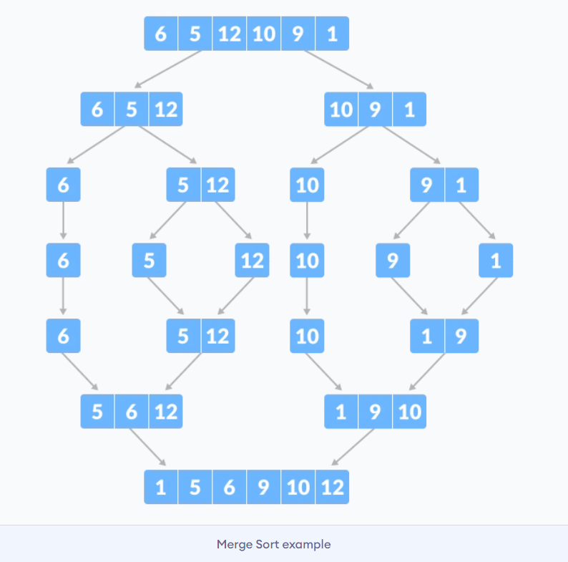
MERGE SORT

Slide 26
REFERENCES
Data Structures And Algorithms Made Easy: Data Structures And Algorithmic Puzzles by Narasimha Karumanchi
https://www.programiz.com/
https://www.geeksforgeeks.org/
https://www.tutorialspoint.com/

